Slide 1

Board game recommendation system
Roy Shpringer-Yair Eshel-Orel Mishael

Slide 2
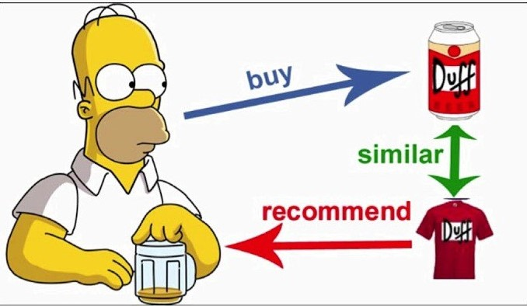
Project purpose and general background
The purpose of the project-is to establish a recommendation system for a store that sells board games. By predicting the score that a specific user will give to a new game we can understand Should it be recommended to the user or not.
Source of information - The data set originates in Kaggle and contains the comments of buyers from the “Board Game Geek” website for board games.
Data structure - The data set contains two files:
1. 15 million reviews of board game buyers. When there are 300,000 unique users in the file.
2. Technical details of all the board games on the site when there are 20k unique games in the file.

Slide 3
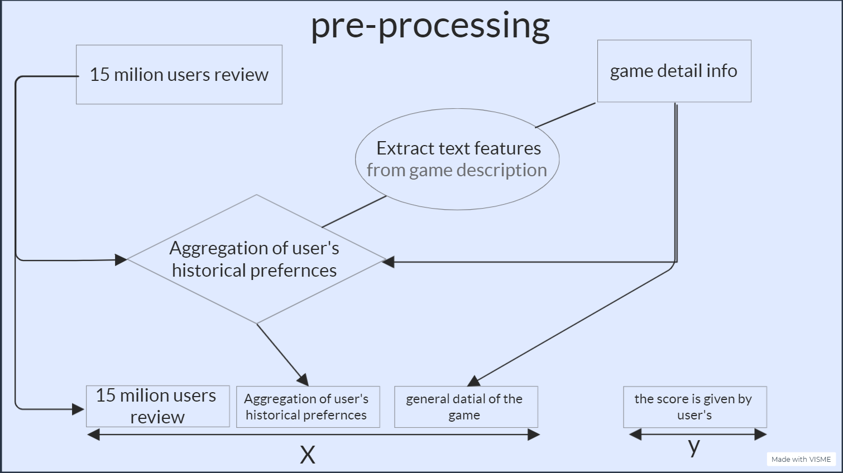

Slide 4
A Simplified game example
title: Five tribes
yearpublished: 2014
minplayers: 2
maxplayers: 4
boardgamecategory: ['Animals', 'Arabian', 'Fantasy', 'Mythology']
boardgamemechanic: ['Auction/Bidding', 'End Game Bonuses']
averageweight: 2.8516
Game Description: Crossing into the Land of 1001 Nights, your caravan arrives at the fabled Sultanate of Naqala. The old sultan just died....

Slide 5
A Processed game example
game__review__mean_plus_std: 9.068 game__review__mean_minus_std: 6.50 game__weight__2.01-2.5: 0.0 game__weight__2.51-3.0: 1.0 game__category__card_game: 0.0 game__category__fantasy: 1.0 | game__players__couples: 1.0 game__players__multiplayers: 1.0 game__players__party: 0.0 game__desc_nlp__five: 0.46 game__desc_nlp__win: 0.11 game__desc_nlp__dice: 0.0 game_years_2010-2015: 1.0

Slide 6
A Simplified User example
506155 | 1000salmons | 157354 | Five Tribes | 8.0
1048906 | 1000salmons | 128882 | The Resistance: Avalon | 7.5
4433087 | 1000salmons | 2407 | Sorry! | 4.5
5143551 | 1000salmons | 178900 | Codenames | 8.0
5295373 | 1000salmons | 1294 | Clue | 5.0
.
.
.

Slide 7
A Processed User example
user_reviews__mean_plus_std: 9.2 user_reviews__minus_plus_std: 6.2 count__weight__2.01-2.5: 4 mean__weight__2.01-2.5: 8.5 count__weight__2.51-3.0: 10 mean__weight__2.51-3.0: 6.4 ... | mean__category__fantasy: 8.0 mean__desc_nlp__five: 3.7 mean__desc_nlp__win: 1.9 mean__desc_nlp__dice: -1 mean_years_2010-2015: 6.3

Slide 8

Model building
Technical Challenges- Because our base file contains 15 million rows and joins from other tables should produce 400 new columns, a standard computer could not do this and so it was necessary to use aws virtual machines.
Batch division - even the virtual machine can not do the join operation at once and therefore it is necessary to divide the test and validation and the train into several parts.
incremental learning - xgboost booster is enabled on every batch of data. When using incremental learning each run of the model learns from previous runs and The score of the model improves.
sample weight- Each user received a weight according to the number of his reviews, the reason being that from a small number of reviews it is difficult to deduce a user's preferences.
In the original planning, we wanted to include over 2000 image processing features produced from the ResNet network. But due to the size of the information, this was not possible.

Slide 9
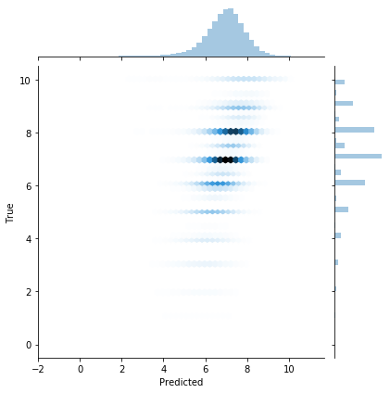
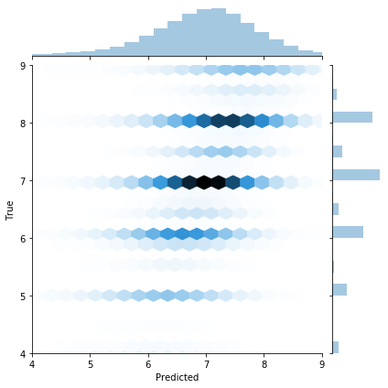
Main model evaluation results
rmse = 1.24 (model input 15 million records)

Slide 10
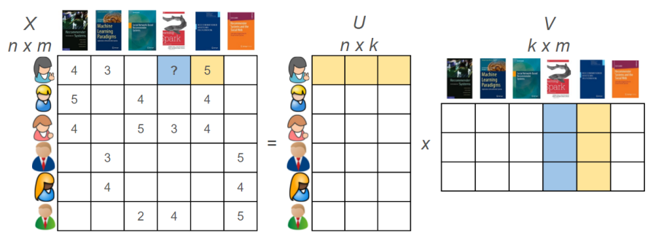
Matrix Factorization using PyTorch
Matrix factorization - a key method for creating recommendation systems. We use decomposition to break-down the users-games-rating pivot table into two small games and users tables where the columns are unknown latent features (factors ).
the goal is to find the features by first embedding each user or game as a tensor and then modulate each vector’s weight with gradient descent optimizer.
The rating in the original table is a Dot-Product of the rows and columns of the new tables:
* Model’s Advantages : fast , and no need for information other than rating

Slide 11
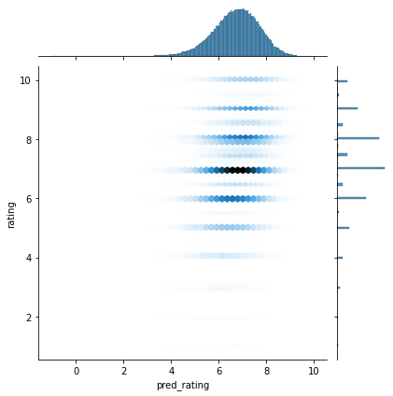
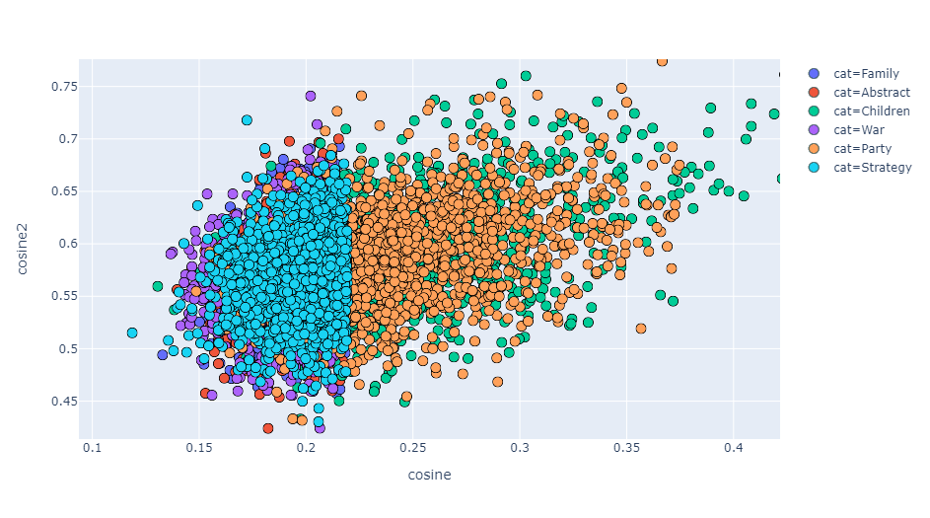
Matrix factorization evaluation results: rmse = 1.68 (model input 1 million records)
W
We can use cosine similarity to plot the games in a category-clusters

Slide 12
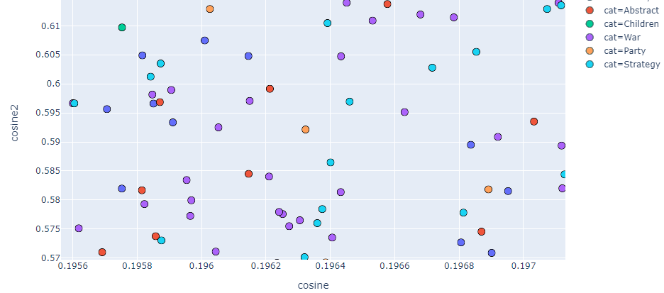


We can also use the cosine distance to find similar games, like in this case below:

Slide 13
New things we learned during project preparation
Preparation of large files for machine learning model.
incremental learning.
The subject of recommendation systems.
matrix factorization

